Slide 1
A Brief History of Real-Time Linux
Sven-Thorsten Dietrich
Montavista Software, Inc.
EB II Room 1226
April 12, 2006: 1:50 - 2:45
Raleigh, NC

Slide 2
Real Time Overview
Real-Time Linux Background
  Real-Time Linux Evolution
  Real-Time Linux Enablers
Real-Time Inhibitors
  Interrupt Latency
  Kernel Locking
  Legacy Locking
Real-Time Kernel
  Interrupt Handlers, PI Mutex
  Performance / Benchmarks
  Acceptance
  Virtualization
Brief History of Real-Time Linux - Linux World 2006

Slide 3
Evolution of Linux
Early Linux Not Designed for Real-Time Processing
  Early Linux (1.x Kernel) installations on retired Windows PCs
    Old/Obsolete hardware useful under Linux due to efficiency of O/S
    Linux outperformed Windows in reliability and uptime (still does)
  Linux Design: Fairness, Throughput and Resource-Sharing
    Basic Unix development design principles applied in Kernel
    Heavily (over)-loaded systems continue to make progress
    Does not drop network connections or starve users / applications
  Fairness- and Resource-Sharing Design is Linux's Strength
    contributed to make Linux competitive and popular in the enterprise-server and development-application environments
    Gave rise to RedHat and others.
    Essential to the evolution of Linux, endemic of UNIX legacy
Brief History of Real-Time Linux - Linux World 2006

Slide 4
Why Linux in Real-Time Systems?
Not because of the Kernel’s Real-Time Performance!
  UNIX-legacy Operating Systems were designed with operating principles focused on throughput and progress
    User tasks should not stall under heavy load
    System resources must be shared fairly between users
  Fairness, progress and resource-sharing conflict with the requirements of time-critical applications
    VIP vs. General Admission
  UNIX systems (and Linux) are historically not Real-Time OS
  Linux has lagged many commercial Unix's in Real-Time performance-enhancement and Real-Time capabilities
    Solaris, LynxOS, QNX
    SCO
Brief History of Real-Time Linux - Linux World 2006

Slide 5
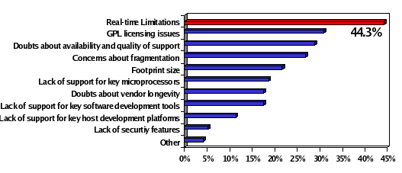
Why Real-Time in Linux Systems (Embedded)
Most Important Factors Inhibiting Linux Adoption
Data from VDC, “Linux’s Future in the Embedded Systems Market”, June 2004
Brief History of Real-Time Linux - Linux World 2006

Slide 6
Real-Time in Handheld & Embedded Systems
Cost / Performance / Power / Weight Compromise
  Competitive, High-Volume, Low-margin Markets
  Maximum Feature-set, Add-ons, Responsive UI feel
  Device specs: minimal CPU & Memory & Battery Powered
  Minimal CPU = High CPU utilization
  High CPU load + Time-Critical functionality → RT specs
  Real-time Requirements will never be alleviated by Improvements in Hardware Performance / Efficiency
    Software utilizing latest hardware technologies easily keep up with, and usually out-paces, advances in hardware technology
    If you don't believe that, go shopping (for a mobile phone)
Brief History of Real-Time Linux - Linux World 2006

Slide 7
Real-Time Linux 2.6 Enablers
Pro-Audio Performance Requirements
  Audio Community Involved in Kernel-Preemption since 2.2
  Audio Community strongly Endorsing RT technology
Embedded Application Domain
  Single-Chip, Mobile Applications (Wireless / Cellular Handsets)
  Predictable OS performance eliminates HW design uncertainty
    Reliable Prototyping and Improved Product Scheduling
Multimedia Carrier (QOS) Application Domain
  Telephony, Audio / Video / Multimedia / Home Entertainment
Fine-Granular Preemption improves SMP scalability
  Mainstreaming of SMP Technology
    Dual / Quad / Octa - Core Intel, AMD, PPC, Arm
Brief History of Real-Time Linux - Linux World 2006

Slide 8
Real-Time and Linux Kernel Evolution
Gradual Kernel Optimizations over Time
  SMP Critical sections (Linux 2.x)
  Low-Latency Patches (Linux 2.2)
  Preemption Points / Kernel Tuning (Linux 2.2 / 2.4)
  Preemptible Kernel Patches (Linux 2.4)
  Fixed-time “O(1)” Scheduler (Linux 2.6)
  Voluntary Preemption (Linux 2.6)
In 2003-04 Linux 2.6 RT Technology Regressed
  Early Linux 2.6 Real-Time Performance was worse than 2.4 Kernel Performance
  Audio Community and others balked at moving to 2.6 Kernel Base
  What Happened?
Brief History of Real-Time Linux - Linux World 2006

Slide 9
Real-Time Inhibitor: Critical Section Locking
Linux 2.6 Kernel Critical Sections are Non-Preemptible
  Critical sections protect shared resources, e.g. hardware registers, I/O ports, and data in RAM
  Critical sections are shared by Processes, Interrupts and CPUs.
  Effective protection is provided by the Spin-Lock Subsystem
  Critical sections must be locked and unlocked
  Locked critical sections are not preemptible
  Linux 2.6 Kernel has 11,000 critical sections
  Exhaustive Kernel testing to identify worst-case code paths
  Labor-intensive cleanup of critical sections
  No control over 3rd party drivers
  Worst-case after cleanup still not acceptable
  Maintenance, community education, policing / regression testing
Brief History of Real-Time Linux - Linux World 2006

Slide 10
Real-Time Inhibitor: Interrupt Handlers
Linux 2.6 Kernel: Unbounded IRQ subsystem latencies
  Task-Preemption latency increases with hardware-interrupt load
  Interrupts cannot be preempted
  No Priorities for Interrupts
    IRQ Subsystem always preempts tasks unconditionally
  Unbounded SoftIRQ subsystem (“Bottom Half Processing”)
    Activated by HW IRQs (Timers, SCSI, Network)
    SoftIRQs re-activate, iterate
  Driver-level adaptations
    Network Driver NAPI adaption reduces D.o.S. effects of high packet loads
Brief History of Real-Time Linux - Linux World 2006

Slide 11
Real-Time Inhibitor: Legacy Locking
Existing Locking Subsystems are not Priority-Aware
  System semaphore
    Counting semaphore used to wake multiple waiting tasks
    No support for priority inheritance
    No priority ordering of waiters
  Big Kernel Lock (BKL)
    Originally non-preemptible, now preemptible using system semaphore
    Can be released by blocking tasks, re-acquired upon wake-up
    No priority-awareness, or priority inheritance for contending tasks
  RCU (Read-Copy-Update) Locks in Network subsystem
    Read-optimized cached locking requiring race-free invalidation
  Read – Write Locks
    Classical blocking / starvation issues with no priority awareness
Brief History of Real-Time Linux - Linux World 2006

Slide 12
The Fully Preemptible Linux Kernel
Dramatic Reduction in 2.6 Preemption Latencies
  Multiple Concurrent Tasks in Independent Critical Sections
  Generally Fully Preemptible → “No Delays”
    Non-preemptible: Interrupt off paths and lowest-level interrupt management
    Non-preemptible: Scheduling and context switching code
Design Flexibility
  Provides Full Access to Kernel Resources to RT Tasks
  Supports existing driver and application code
  User-space Real-Time
Optimization Flexibility
  RT Tasks designed to use Kernel-resources in managed ways can reduce or eliminate Priority-Inheritance delays
Adequate Instrumentation
  Latency timing, latency triggers & stack tracing, histograms
Brief History of Real-Time Linux - Linux World 2006

Slide 13
Linux Real-Time Technology Overview
Linux 2.6 Kernel Real-Time Technology Enhancements
  Preemptible Interrupt Handlers in Thread Context
  IRQ-Disable Virtualization for Drivers
    IRQ threads disabled without masking hardware
  Integrated Kernel Mutex with Priority Inheritance (PI)
    Preemptible PI Mutex protects Kernel Critical Sections
  PI Mutex Substituted for Non-Preemptible Kernel (SMP) Locks
    Big Kernel Lock (BKL) converted to PI Mutex
    Spin-Locks converted to PI Mutex
    Read-Write Locks converted to PI Mutex
    RCU Preemption Enhancements
  High Resolution Timers
  User-Space Mutex
    Robustness / Dead-Owner / Priority Queuing
Brief History of Real-Time Linux - Linux World 2006

Slide 14
Thread-Context Interrupt Handlers
Real-Time Solution: Interrupts in Thread Context
  Functionality of IRQ Handlers does not require IRQ context
    no special “IRQ Mode” Instructions
    IRQ Thread can have private stack
    Default: IRQs run in threads
  Demote IRQ Handler Execution to Thread-based function
    IRQ Handlers scheduled in bounded-time by O(1) scheduler
    Inter-leaving of RT and IRQ tasks
    Real-Time tasks at Higher Priority than IRQ handlers
  Incoming IRQ returns immediately
    IRQ activates corresponding Handler-thread (wake_up_process)
  RT IRQs operate in Vacated IRQ execution-space
    RT IRQs do not contend with common IRQs - Runs at IRQ Priority
    RT IRQ Latency Predictable
    Subject to Minimal Variation
  Promoted SoftIRQ Daemon Processes ALL Bottom-half activity
    SoftIRQs Preemptible
Brief History of Real-Time Linux - Linux World 2006

Slide 15
Thread-Context Interrupt Handlers
Threaded IRQs Pros
  RT IRQs do not contend with common IRQs
  IRQ Processing does not Interfere with task execution
  Flexible priority assignment
    can be arranged to emulate hardware-based priorities
  Interrupts run fully preemptible
Threaded IRQs Cons
  IRQ-Thread Overhead
    Scheduler must run to activate IRQ Threads
  IRQ Thread Latency
    IRQs no longer running at the highest priority
    Full task switch required to handle IRQ
    Response-Time / Throughput tradeoff
Brief History of Real-Time Linux - Linux World 2006

Slide 16
Priority-Inheriting Kernel Mutex
New Kernel+Userspace Synchronization Primitive
  Fundamental RT Technology
    Preemptible alternative to spin-locked / non-preemptible regions
    Expands on “Preemptible Kernel” Concept
    Spinlock typing preserved (maps spin_lock to RT or non-RT function )
  Enabler for User-space Real-Time Condition Variables & Mutexes
  Priority Inheritance
    Eliminate Priority Inversion delays
  Priority-ordered O(1) Wait queues
    Constant-time Waiter-list processing
    Minimize Task Wake-Up latencies
  Deadlock Detect
    Identify Lock-Ordering errors
    Reveal Locking cycles
Brief History of Real-Time Linux - Linux World 2006

Slide 17
PICK_OP: Spinlock->Mutex Function Mapping
Preprocessor determines static function mapping
  Compile-time mapping, based on declared type
#define spin_lock(lock) PICK_OP(raw_spinlock_t, spin, _lock, lock)
PICK_OP
#define PICK_OP(type, optype, op, lock) \
do { \
if (TYPE_EQUAL((lock), type))
_raw_##optype##op((type *)(lock)); \
else if (TYPE_EQUAL(lock, spinlock_t)) \
_spin##op((spinlock_t *)(lock)); \
else __bad_spinlock_type(); \
} while (0)
TYPE_EQUAL
#define TYPE_EQUAL(lock, type) \
__builtin_types_compatible_p(typeof(lock), type *)
Brief History of Real-Time Linux - Linux World 2006

Slide 18
Real-Time Linux Kernel Evolution
Gradual SMP-Oriented Linux Kernel Optimizations
Early Kernel 1.x
No Kernel preemption
SMP Kernel 2.x
No Kernel preemption, “BKL” SMP Lock
SMP Kernel 2.2 - 2.4
No preemption, Spin-locked Critical Sections
“Preempt” Kernel 2.4
Kernel Preemption outside Critical Sections
Spin-locked Critical Sections
Current Kernel 2.6
Kernel Preemption outside Critical Sections,
Preemptible “BKL”, O(1) Scheduler
“RT-Preempt” Kernel
Kernel Critical sections Preemptible
IRQ Subsystem Prioritized and Preemptible
Mutex Locks with Priority Inheritance
High-Resolution Timers
Brief History of Real-Time Linux - Linux World 2006

Slide 19
Kernel Evolution: Preemptible Code
Kernel 2.0
Kernels
2.2-2.4
Preemptible
Kernel 2.4
Kernel 2.6
Real-Time
Kernel 2.6
Preemptible
Non-Preemptible
Brief History of Real-Time Linux - Linux World 2006

Slide 20
Real-Time Linux 2.6 Performance
Real-Time Linux 2.6 Kernel Performance
  Far exceeds most stringent Audio performance requirements
  Enables sub-millisecond control-loop response
  Enables Hard Real Time for qualified RT-aware Applications
SMP Kernel Performance
  SMP-safe code is by definition preemptible
  Any code that allows concurrent execution by multiple CPUs, also allows context switching and therefore preemption
  Increased preemptible code surface in the Kernel also increases SMP throughput / efficiency
Brief History of Real-Time Linux - Linux World 2006

Slide 21
FRD
Fast Real-time Domain
Measurement tool
Thread 1 runs
Thread 2 runs
IRQ handler
Schedules
Thread 1
Thread 1
Schedules
Thread 2
etc
Δt
Δt

Slide 22
Benchmarks
Target machine:
  Intel® Celeron® 800 MHz
Workload applied to the target system:
  Lmbench
  Netperf
  Hackbench
  Dbench
  Video Playback via MPlayer
CPU utilization during test:
  100% most of the time
Test Duration:
  20 hours
Brief History of Real-Time Linux - Linux World 2006

Slide 23
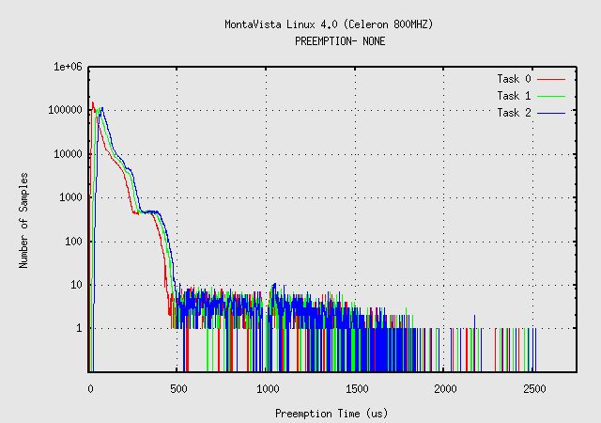
Linux 2.6 Kernel – No Preemption
Line Chart Title
Source:
Brief History of Real-Time Linux - Linux World 2006

Slide 24
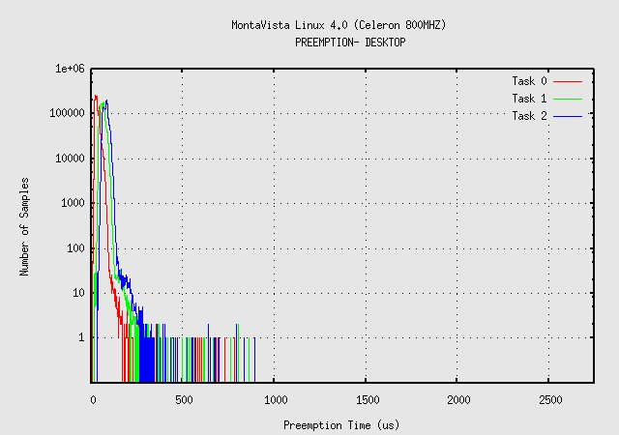
Linux 2.6 Kernel – Preemptible Kernel
Line Chart Title
Source:
Brief History of Real-Time Linux - Linux World 2006

Slide 25
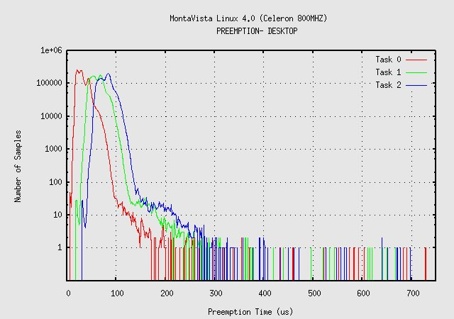
Linux 2.6 Kernel – Preemptible Kernel (scaled)
Line Chart Title
Source:
Brief History of Real-Time Linux - Linux World 2006

Slide 26
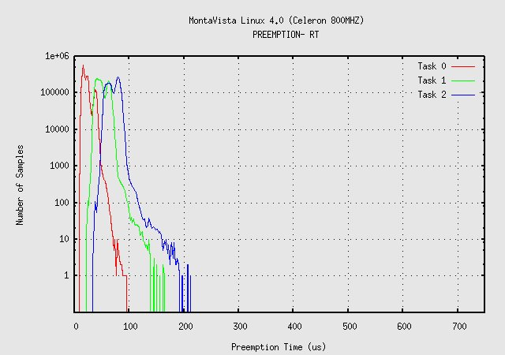
Linux 2.6 Kernel – Real-Time Preemption
Line Chart Title
Source:
Brief History of Real-Time Linux - Linux World 2006

Slide 27
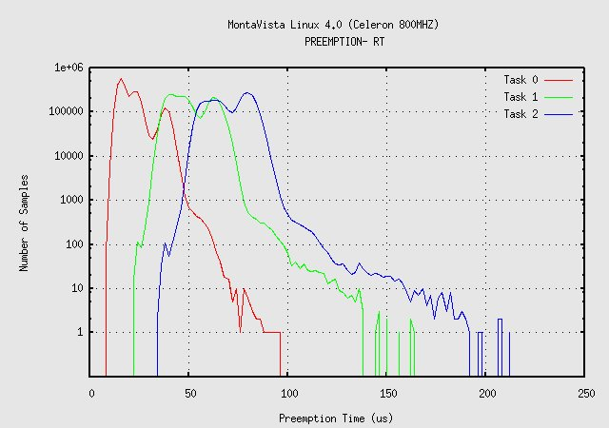
Linux 2.6 Kernel – Real-Time Preemption (scaled)
Line Chart Title
Source:
Brief History of Real-Time Linux - Linux World 2006

Slide 28
Real-Time Linux 2.6 IRQ Latency
Linux-2.6.12-rc6-RT vs. Adeos / I-Pipe
+--------------------+------------+------+-------+------+--------+
| Kernel | sys load | Aver | Max | Min | StdDev |
+====================+============+======+=======+======+========+
| | None | 13.9 | 55.5 | 13.4 | 0.4 |
| | Ping | 14.0 | 57.9 | 13.3 | 0.4 |
| Vanilla-2.6.12-rc6 | lm. + ping | 14.3 | 171.6 | 13.4 | 1.0 |
| | lmbench | 14.2 | 150.2 | 13.4 | 1.0 |
| | lm. + hd | 14.7 | 191.7 | 13.3 | 4.0 |
+--------------------+------------+------+-------+------+--------+
| | None | 13.9 | 53.1 | 13.4 | 0.4 |
| | Ping | 14.4 | 56.2 | 13.4 | 0.9 |
| with RT-V0.7.48-25 | lm. + ping | 14.7 | 56.9 | 13.4 | 1.1 |
| | lmbench | 14.3 | 57.0 | 13.4 | 0.7 |
| | lm. + hd | 14.3 | 58.9 | 13.4 | 0.8 |
+--------------------+------------+------+-------+------+--------+
| | None | 13.9 | 53.3 | 13.5 | 0.8 |
| | Ping | 14.2 | 57.2 | 13.6 | 0.9 |
| with Ipipe-0.4 | lm.+ ping | 14.5 | 56.5 | 13.5 | 0.9 |
| | lmbench | 14.3 | 55.6 | 13.4 | 0.9 |
| | lm. + hd | 14.4 | 55.5 | 13.4 | 0.9 |
+--------------------+------------+------+-------+------+--------+
(Source: OperSys.Com Benchmarks)
Brief History of Real-Time Linux - Linux World 2006

Slide 29

Real-Time Response vs. Throughput
Efficiency and Responsiveness are Inversely Related
  Overhead for Real-Time Preemption
    Mutex Operations more complex than spinlock operations
    Priority Inheritance on Mutex increases task switching
    Priority Inheritance increases worst-case execution time
    Interrupt overhead
      Additional Task Switching
      Interrupt Preemption → Interrupt throughput reduction
Throughput
High responsiveness
Brief History of Real-Time Linux - Linux World 2006

Slide 30
Real-Time Systems Design
Design flexibility allows much better worst case scenarios
  Task Independence
  Kernel resources utilized in managed ways
  Delays eliminated or reduced

Slide 31
Real-Time Linux 2.6 Acceptance
Community Status
  RT Kernel Patch: development-stable in community
  Generic Implementation facilitates Portability, Stability
    Intel, AMD 32-bit and 64-bit
    Arm
    PPC
Real-Time Linux 2.6 Technology Confidence
  RT Preemption reveals Hard-to-find SMP Bugs
    Concurrency bugs easier to trace on UP Systems
    Sanctioned by Kernel Summit as Constructive R & D
  Growing Community awareness of Performance Issues
  Audiophile Linux Distributions shipping RT Kernel
Brief History of Real-Time Linux - Linux World 2006

Slide 32
Real-Time and Linux Kernel Evolution
Today
  Real–Time Preemption
  User-Space Robust Mutex
  High Resolution Timers
Future Innovation
  RT “awareness” extensions to Power-management subsystem
    Quick CPU Power+Freq Ramp for RT Tasks
    Power Level Scheduling Classes
  Virtualization / Hypervisor support for Real-Time
    Rate-Monotonic scheduling of RT tasks in independent VMs
    Per-VM QoS guarantees
Brief History of Real-Time Linux - Linux World 2006

Slide 33
Linux Real-Time is Open Source
Ongoing Real-Time Development
  Patch against current Community Kernel (2.6.16)
  Maintained by Ingo Molnar / RedHat
  Contributions from Community
  Architectures: i386, x86_64, PPC 32/64, Arm
Download from:
  http://people.redhat.com/~mingo/realtime-preempt/
Brief History of Real-Time Linux - Linux World 2006

Slide 34
More Information
Questions?
Contact me: sven@mvista.com
MontaVista Software
  www.mvista.com
Brief History of Real-Time Linux - Linux World 2006

